Slide 1
WELCOME
SU Elections 2024 Training

Slide 2
Candidate Photos

Slide 3
Icebreaker

Slide 4
Meet The Team ?
Max McLoughlin – Union CEO
Richard Broome – Membership Services Manager
Nadine Al-Kudcy – Student Voice & Activities Manager
Fawziyyah Ahmed – Student Engagement Coordinator (Voice)
Amanpreet Sidhu – Student Engagement Coordinator (International)
Rachel Smith – Deputy Manager and Student Engagement Coordinator (Societies)
Daniel Smith – Student Engagement Coordinator (Clubs)
Natalie James- Wellbeing Coordinator

Slide 5
Icebreaker…
What do I want to gain from this training/experience?
What resources do I need from my support group/SU?
What is my vision for this role?

Slide 6
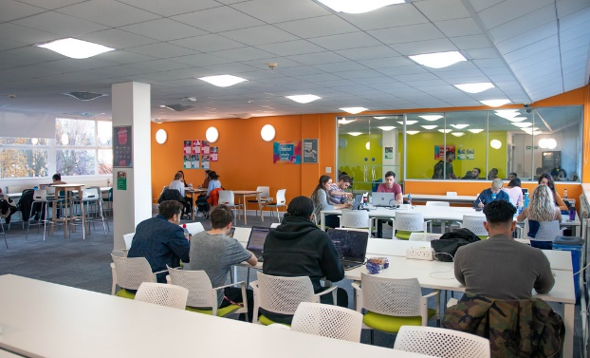
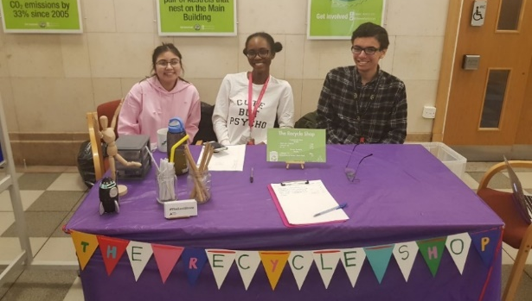
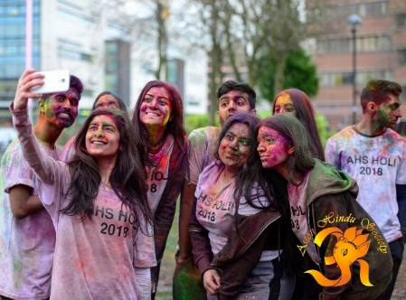
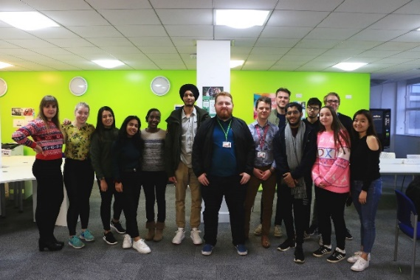
Your SU
Is a democratic, student-led organisation
A charity, but with commercial outlets (shop, bar)
Run by a team of Officers – five full-time Officers, and voluntary Officers
Supported by a team of permanent staff, as well as student & placement staff

Slide 7
Mark these dates on your calendar
Manifesto Deadline | Wednesday, 6th March 2024, at 10 am
Candidate Name Release Start of Campaigning | Friday 8th March 2024, at 12 noon.
Voting Opens | Monday 11th March 2024, at 9am
Candidate Question Time | Monday 11th March 2024, at 1pm SU 1st Floor Activity Hall
Voting Closes | Thursday 14th March 2024, at 2pm
Election Results | Friday 15th March 2024, from 2pm SU 1st Floor Activity Hall
KEY DATES

Slide 8
Candidate Question Time
Candidate Question time is an opportunity for you to answer any questions about your motivations and manifesto. This allows students to learn more about you, what you believe in, what you stand for, and what you want to achieve in the role. Attendance is not mandatory, however it is highly encouraged, as it is a great opportunity for you as a candidate to have your say.
Students will be invited to pre-submit their questions via a survey and You will also get questions in advance. The questions will be different for each role.
Candidate Question Time is for Full-Time roles only.
When: Monday 11th March 1pm to 3pm
Where: SU 1ST Floor Activity Hall.

Slide 9
Potential voters by colleges…

Slide 10
Potential voters by year of study…

Slide 11
Jargon Buster aka what does that mean?
Candidate – A student who is running in the elections
Campaigning – How candidates try to convince other students to vote for them. It might include handing out leaflets and talking to students on campus, or marketing online.
Manifesto (poster/video) – A poster/video that candidates create to explain why students should voter for them. It may include the candidates experience, motivation, and policies.
Deputy Returning Officer – An election expert who ensures that the election is fair, transparent & democratic, and deals with complaint and other issues.
Question Time - An event where candidates are asked questions by students.
RON – R.O.N. stand for Re-Open Nominations. Students can vote for R.O.N. in the elections to signify that they don’t think any of the candidates are suitable for the role.

Slide 12
Rules & Regulations
ELECTION RULES 2024
1. No coercion.
This means candidates cannot pressurise or force students to vote for them. Standing over a student and watching them vote may be seen as coercion. Candidates should not give electronic devices to voters to make them vote.
2. No bribery (financial or otherwise).
This means that candidates and campaign teams cannot pay students to vote for them or offer to do something for them in order to get them to vote.
3. No illegal discrimination.
Candidates should not do anything that could be discriminatory against protected characteristics (Gender Identification, Race, Religion, Disability, and Sexual Orientation).

Slide 13
Rules & Regulations
4. Campaigning.
All candidates must stick to the fixed budget. Overspending of the budget will result in disqualification.
In-person campaigning is allowed, as long as you respect individuals’ boundaries.
Campaigns should be sustainable and accessible.
Digital campaigning should follow social media platform rules and regulations. For further information, refer to SU Guidance. Spamming and trolling types of behaviour may be considered to be a breach of this rule.
Pre-campaigning is not allowed. This means campaigning before campaigning has been permitted by the SU.
Candidates are allowed to create social media accounts and populate them with followers ONLY. Candidates should not populate these accounts with posts or stories prior to the start of campaigning.
No posters and/or campaigning are allowed in the library and the quiet study area on the 7th floor of the Main Building.

Slide 14
Rules & Regulations
5. All campaign materials is subject to scrutiny by the Deputy Returning Officer (DRO).
This means that manifestos, posters and flyers/leaflets will be subject to scrutiny.
6. All current Aston University and Aston SU rules must be complied with.
Local rules apply. For example, the Library will not allow any campaigning inside the Library. This includes speaking to anyone within the library and its premises. A breach of this local rule is a breach of the Election Rules.
Different parts of Aston University will have different rules. Some Colleges may allow candidates to leave leaflets in their office. Others may not. If they allow 1 candidate to leave leaflets, they must allow all candidates to do so. The university is not allowed to show preference to one candidate over another.

Slide 15
Rules & Regulations
GUIDING PRINCIPLES 2024
1. All Candidates should have equal and fair access to be able to communicate with students.
2. Current officers or students in a position within the union/university should not use that position to advantage themselves. This includes SU Student Reps using email lists/social media that they have in their role to contact voters.
3. Candidates should not canvas or seek the support of Aston University or SU staff.
4. There will be equal support offered to all candidates.
5. Candidates must be open and honest in their campaigning
6. All students should be given a free and fair choice at the point of voting.

Slide 16
Rules & Regulations
7. Voters should not be harassed or given direct instruction on how to vote at the point they are making their vote
8. Campaigning should be done by Aston students to Aston students.
9. Negative campaigning should be avoided. This is focussing on bad things or perceived bad things about other candidates. Campaigning should be based on what you will bring to the role.
10. Ignorance will not normally be considered a defence.
11. Teams/slates are permitted. The DRO should be informed when a slate/team exists. If the DRO is not informed that a group of candidates are standing on a slate/team the DRO will look to the facts and the reality of the situation to decide whether candidates are standing as part of a slate/team.
12. Any complaints should be submitted to the DRO in a timely manner and at the very latest, one hour after voting has closed.

Slide 17
Rules & Regulations
13. All candidates must off set their printing by following these rules:
a. For every 100 flyers and/or leaflets you must account £5 from your budget to plant a tree**.
b. For every 50 posters* you must account £5 from your budget to plant a tree**.
c. Please be mindful of the adhesive you use to put up your flyers/leaflets/posters i.e., no tape or stick glue. You can use blue/white tac.
* The Students’ Union considers A5/A6 sizes as flyers, anything above A4 is considered a poster.
** All printing should be accounted for via claim forms and submitted to union.voice@aston.ac.uk. The Student Voice Team will calculate your return after off-setting your printing.
14. Candidates should not film other candidates or individuals without seeking permission from them.

Slide 18
Rules & Regulations
BREACHES OF ELECTION RULES
Any breaches of rules should be reported to the Deputy Returning Officer on union.returningofficer@aston.ac.uk.
Please note, in order for the DRO to make a valid decision, evidence is required.
If you witness a breach of campaigning please indicate the specific time, date and location, to assist with the investigation. Complaints will be accepted up until 1 hour after the close of voting.
What happens if the rules are broken?
Some examples:
The candidate could be asked to issue an apology, and this could be placed on the SU website/social media.
A candidate could be disqualified from the election.
A candidate can face an internal SU code of conduct procedure.
A candidate could be reported to the university and/or other authorities.

Slide 19
Rules & Regulations
It is your responsibility to familiarise yourself with the Rules & Regulations.

Slide 20
The Budget
Candidates will have a budget that they can use to purchase materials for their election campaign.
All candidates have a budget of £50.
Do not go over your allocated budget. Keep track of what you are spending. If you spend nothing, you should let us know that this is the case.
EVERYTHING you buy and use must be included in your budget. You are not allowed to ‘top up’ your budget with your own money.
You will get an additional £10 towards you budget if you include a manifesto point related to one of the UN Sustainable Development Goals
How does it work?
Candidates will spend their budget and reclaim their spending by completing a Personal Claim form. All claim forms are due Thursday 14th March @3pm.
We will send the form to your Aston student email. Please send a digital copy of the form, accompanied by full, itemised receipts of your campaign spending.
ALL CLAIMS will need to be handed into Student Voice by 3pm on Thursday 14th March.
Notes:
Need to highlight which manifesto point is related to the UN Sustainable Development Goals

Slide 21
UN SDGs

Slide 22
What is a Manifesto?
What is a manifesto?
A manifesto is a short text that candidates can use to try and convince voters to vote for them. To this end, it usually contains information about:
Who you are and what position you are running for
Why you want to win the election – why are you passionate about this role?
What would you do if you won the election – what projects and policies would you introduce?
What experience and skills you have that make you a good candidate – have you been involved in the SU before? Have you worked on projects related to the role?
Often it will include a slogan – to make your campaign more memorable!

Slide 23
Creating a Manifesto
It’s a chance for you to ‘talk’ to students you might not meet while campaigning.
How can you get them on your side?
What do students care about?
Ask your friends!
What would make people vote for you?
For further guidance on how to make a great poster/video manifesto please refer to the Blackboard training.

Slide 24
Creating a Manifesto
Who am I?
My name’s Stu Dent and I’m running to be your President!
Why am I running?
I live and breathe the Students’ Union, and I want to use my passion to make sure that the Students’ Union can
thrive in the future.
What will I do?
If you elect me as your President, I will:
Push to ensure that students get a fair accommodation deal on campus
Make scrutiny of your Officers more transparent
Why vote for me?
I’ve got bags of experience of working with the student community:
I’m a student rep
I’m chairperson of my society
I work for the University as a Student Ambassador
So, remember: Vote for Stu – he’s thought it through! Voting closes 14th March.

Slide 25
Visual Manifestos
Visual manifestos are a bit different (but mostly the same)…
Visually interesting (a brand, colours…)
Who you are (e.g. a picture of you)
Policies/promises
Experience
Don’t forget to remind people to vote! Link: astonsu.com/vote

Slide 26
Visual Manifestos
Be concise and use clear language
Include key policies but keep them short
Easy to read font on a good readable size
Ask friends to check it over for typos or the ideas you have
Include:
Aston Students’ Union Logo
The vote link: www.astonsu.com/vote/
Voting closing on Thursday 14th March at 2pm
The position you are running for

Slide 27
The technical stuff for visual manifestos..
Sizing and format:
A4 portrait
JPEG Format (as high a resolution as possible)
Programmes you can use include:
Photoshop (if you have access)
GIMP (Free online software similar to Photoshop)
Microsoft Publisher
Canva
Please do not use
Microsoft word or save as a pdf as you cannot display this on the website as an image

Slide 28
Example of a video manifestos…

Slide 29
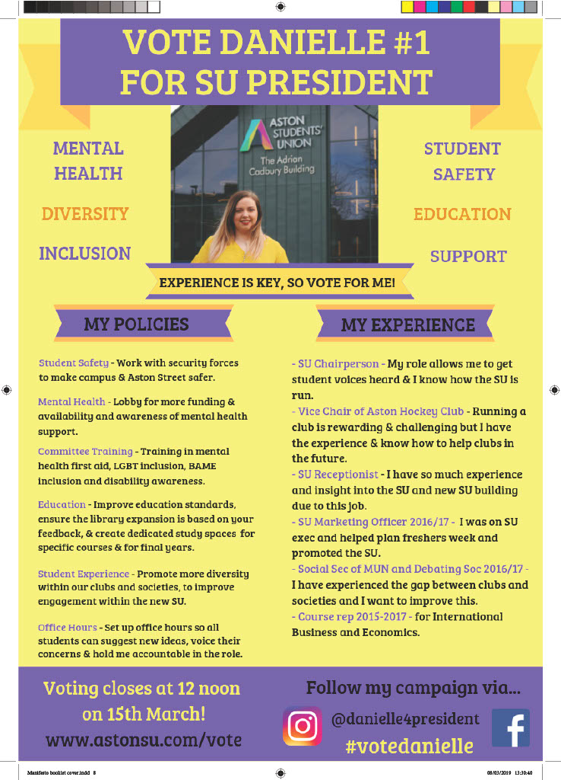
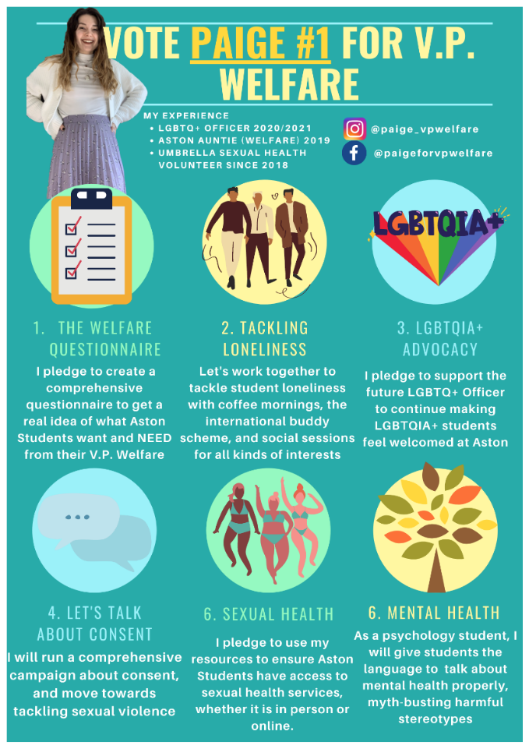
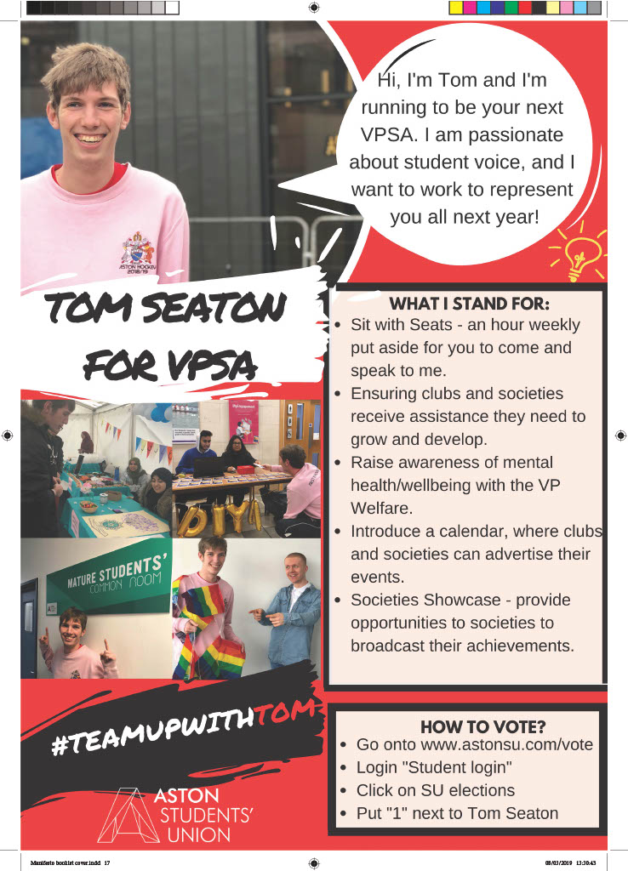
Example of poster manifestos…

Slide 30
Campaigning 101
Campaigning: “working in an organized and active way towards a particular goal, typically a political or social one.”
If you want to win this election, you need people to vote for you! And it’s not enough to just ask your friends to vote; to win you will need to reach lots of different groups of students. To get those votes, you will need to campaign, either online or in person (but probably both). You can do this on your own, or with a team.
Notes:
The definition of campaigning is ‘working in an organised and active way towards a particular goal, typically a political or social one’. Campaigning can be in various methods and forms; in person, online and digital campaigning, posters, videos.
If you want to win the election, you’ll need people to vote for you. It’s not enough for just your friends to vote for you – you’ll need to reach out to lots of different groups of students, and often those you don’t know. To get students to vote for you, you will need to campaign for their vote. You can do this either online or in person, but you will probably do both.
You can do this on your own, or recruit a team to help you. There are rules around others helping you campaign, please ensure you know what they are before instructing others to campaign for you.

Slide 31
Campaigning 101
Methods for campaigning:
Face-to-Face Campaigning – talking to students in person asking them to vote for you.
Online Platforms: Instagram, TikTok, Twitter, LinkedIn, Facebook posts (can be paid. You can also use WhatsApp and/or Discord. (Please refer to the social media guidance on the SU Website, under Election Resources).
Attending events: Club/society events, other on-campus events…
Using creative materials: T-shirts, cardboard, flyers… (as long as it’s sustainable).
Notes:
There are various different methods for campaigning and you can use a variety of these in order to win. These include;
Face to face campaigning – talking to students in person and asking them to vote for you is probably the most effective method for campaigning. Students can put a face to a name and you can put more of a personable approach to campaigning through this way.
Online platforms – using online social media platforms such as Instagram, Tiktok, Facebook and Twitter can help your campaign and to get the word out to students on a larger scale. You can also use paid Facebook/Instagram posts if you wish, but these must be expensed correctly). You can also use Linked In as a platform. You can also use Whatsapp and or Discord. For more information on using online platforms, please refer to the social media guidance on the SU Website, under Election Resources.)
Attending events – if there any events happening during the time you can campaign, this would be a great opportunity to promote yourself and your ideas to individuals. Take a look and see if there any club and society events happening – before attending, you should ask the club or society if they are happy for you to come along and speak to their members. Please remember that if they allow you to come along, then they must allow all other candidates who ask to come as well. There may be other events happening on campus that you can attend.
In order to make yourself more memorable and stand out, you can use creative materials such as making t-shirts, cardboard signs, flyers, banners. Please remember that we are trying to run a sustainable election this year, so try to upcycle or use items you already have.

Slide 32
Campaigning 101
Offline campaigning tips:
Tip #1: Be seen!
Students will vote for the best candidate they know about. If they don’t know about you, they probably won’t vote for you. Your job is to make sure as many people as possible know about you.
Tip #2: Know your speech
You’ll talk to a lot of people. Make sure you can talk about your policies in a short ‘elevator pitch’ that you can give to someone in a few seconds.
Tip #3: Get creative!
You have a budget that you can use to print flyers/leaflets. You can also use the budget to buy material for anything else you want to create for your campaign. Think about how you can use the budget to get the most coverage? How can you make your brand stay in people’s minds?
Notes:
We’ll now go through some tips on in-person campaigning:
Firstly, be seen! Students will vote for the best candidate they know about. If they don’t know about you, then it’s probable that they won’t vote for you. During campaigning it’s important for you to ensure as many people know about you. But this should be done within the election rules, and ensure that you are polite and respect students space. Approach students with a smile and open body language – you don’t want to scare voters.
Secondly, know your speech. You will talk to a lot of people and the more people you talk to, the more you can hone your ‘elevator pitch’. This is something that you can deliver within 30 seconds to a minute about why people should vote for you. Students may often be walking between lectures and may not have lots of time to stop. Think of your best manifesto points and create a speech that is concise and to the point. Be sure as well to tell students the basic information such as how to vote.
And lastly, get creative with your campaigning. You have a budget that can be used to print leaflets and other material to help with your campaign. How best can you use that budget? Think about how you can use the budget to get the most coverage, and what might convince students to vote for you.

Slide 33
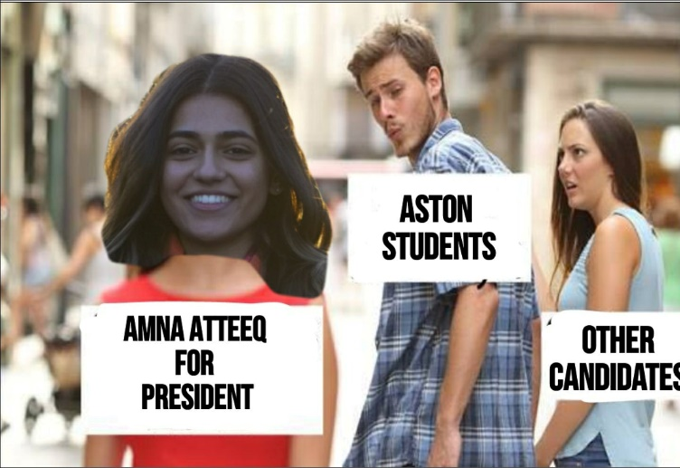
Campaigning 101
Online campaigning:
Viral marketing – can you create something that people will share?
Paid posts – you can sponsor posts on social media (this will come out of your budget)
Think outside the box – how can you expand your reach?

Slide 34
Campaigning 101
Demonstration
Practice your elevator pitch! In pairs/small groups, take it in turns to sell your favourite TV programme/film. You have 1 minute to make it as convincing as possible!
For further guidance on how to make a great poster/video manifesto please refer to the Blackboard training.

Slide 35
How does voting work?

Slide 36
Candidate Wellbeing

Slide 37
Activity 1: "Let's kick off with a fun icebreaker! Candidates, introduce yourselves by sharing the meaning behind your names. For example, Natalie, meaning 'Christmas' in Latin, or Pearline, symbolizing the precious gem found in oysters. Now, let's uncover the stories behind our names!"

Slide 38
Activity 2: "Take a moment to envision your perfect day. Close your eyes and immerse yourself in the details – where are you? What do you see, eat, smell, and do? Jot down your thoughts, and let's share our dreams with the group. Remember, self-care starts with visualizing our happiness and well-being."

Slide 39
Activity 3: "Time to get creative! With the tools provided, craft the ideal candidate with a focus on their well-being. Name them, specify the position they're running for, and highlight what qualities make them an outstanding candidate. Once you're done, share your creation with the group and let's celebrate the power of holistic leadership!

Slide 40
Campaigning is fun
Meet new people
Gain new skills
You get involved with SU activities
You get to be your #1 fan!

Slide 41
But it can be tough
Lack of sleep
Fatigue
Putting yourself out there
Hard
Requires physical and mental energy
How can we prevent burnout?

Slide 42
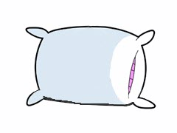
Make sure you…
Eat
Drink
Sleep!
Let your friends know that you might need extra support during campaigning.

Slide 43
Candidate Breakfast!
Candidate breakfast will be held every voting day in the SU from 9am – 11am!
2
Briefing will start at 10:30am.
3
As a candidate running in the elections, you will have a choice of several breakfast items.
4
Come down for breakfast and to learn valuable information about voting!
1

Slide 44
Candidate Wellbeing Drop-in

Slide 45
Candidate Briefing

Slide 46
Good luck!

Slide 47
Questions?

Slide 48
Contacts
For questions/queries contact the Student Voice Team - union.voice@aston.ac.uk
For complaints contact Deputy Returning Officer - union.returningofficer@aston.ac.uk

