Slide 1

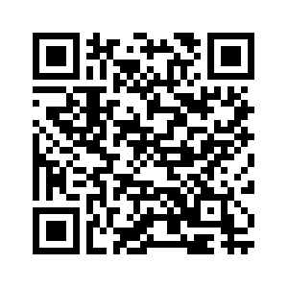

Scan the QR code below to sign up to be a student rep
Student Rep Sign up
Notes:
Fawzy

