Slide 1






Join a thriving community.
Develop crucial employability skills.
Change your Aston experience for the better.
Become a Student Rep.
FIND OUT MORE AND SIGN UP AT
Notes:
Fawzy

Slide 2


Notes:
Fawzy

Slide 3
Sign Up to be a School Rep
Who is a School Rep?
Please note: You can only be a school rep if you were a student rep last academic year!
School Representatives hold a special and limited position, ensuring that they bring a wealth of experience to the table.
To be eligible, you should be in your 2nd year or above and ideally possess experience as a Course Representative or relevant applicable experience. This ensures that you have a strong foundation to effectively communicate and advocate for your peers' needs.
Your role as a School Representative will involve attending crucial meetings, including the Learning and Teaching Committee for your School. These meetings provide a platform to discuss important academic policies, share feedback on curriculum, teaching standards, and student support services.
Becoming a School Representative isn't just a role – it's an opportunity to drive positive change, enhance your leadership skills, and leave a lasting impact on your academic community.
Let your voice be the driving force behind an enhanced educational experience for everyone. Register your interest and help be the change you want to see!

Slide 4
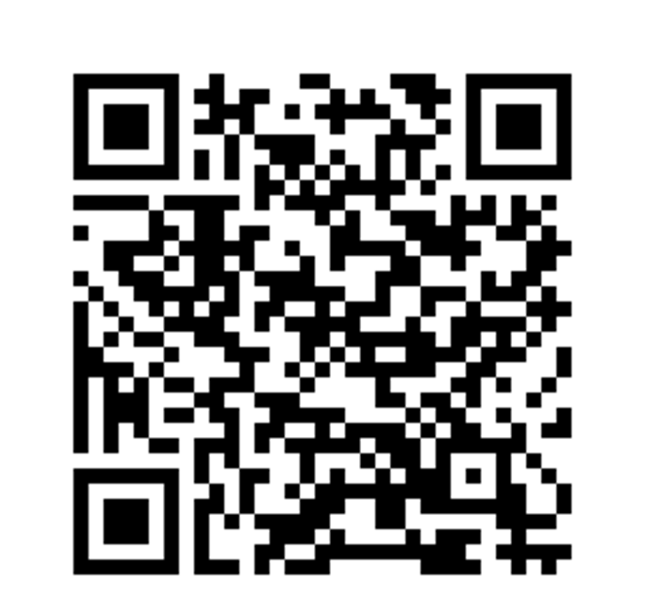
Student Rep and School Rep Sign up
Notes:
Fawzy

